Slide 1
CSE Department, BRAC University
CSE717-Mathematical Programming
Dr Mohammad Kaykobad

Slide 2
Mathematical Programming
Mathematical programming refers to mathematical models used to solve problems such as decision problems. The terms are meant to contrast with computer programming which solves such problems by implementing algorithms which may be designed specifically for a given problem.

Slide 3
Mathematical Programming
Management science is characterized by a scientific approach to managerial decision making. It attempts to apply mathematical methods and the capabilities of modern computers to the difficult and unstructured problems confronting modern managers. It is a young and novel discipline. Although its roots can be traced back to problems posed by early civilizations, it was not until World War II that it became identified as a respectable and well defined body of knowledge.

Slide 4
Mathematical Programming
Management science has been known by a variety of other names. In the United States, operations research has served as a synonym and it is used widely today, while in Britain operational research seems to be the more accepted name.
Some people tend to identify the scientific approach to managerial problem solving under such other names as systems analysis, cost–benefit analysis, and cost-effectiveness analysis.

Slide 5
Mathematical Programming
Some people tend to identify the scientific approach to managerial problem solving under such other names as systems analysis, cost–benefit analysis, and cost-effectiveness analysis.
Mathematical programming, and especially linear programming, is one of the best developed and most used branches of management science. It concerns the optimum allocation of limited resources among competing activities, under a set of constraints imposed by the nature of the problem being studied. These constraints could reflect financial, technological, marketing, organizational, or many other considerations.

Slide 6
Mathematical Programming
When the mathematical representation uses linear functions exclusively, we have a linear-programming model. In 1947, George B. Dantzig, then part of a research group of the U.S. Air Force known as Project SCOOP (Scientific Computation Of Optimum Programs), developed the simplex method for solving the general linear-programming problem. The extraordinary computational efficiency and robustness of the simplex method, together with the availability of high-speed digital computers, have made linear programming the most powerful optimization method ever designed and the most widely applied in the business environment..

Slide 7
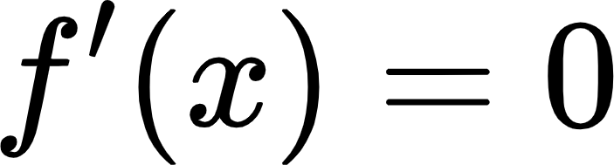
Optimization using calculus
Optimization can be maximizing revenues or profit or minimizing cost, time etc. In the following we introduce these problems in simple examples where differential calculus can be applied to find minimum or maximum of a function under certain constraints. Note that if a function f is differentiable then is a stationary point , and is not necessarily a minimum or a maximum. It can be a point of inflexion. In fact maximum occurs at a point where first nonzero derivative is negative, and for minimum it is positive.
y=x³

Slide 8
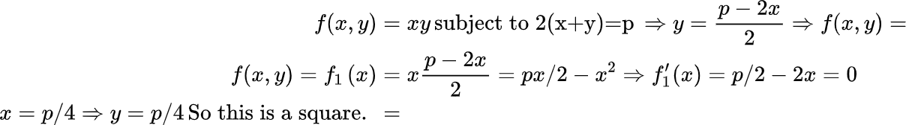
Optimization using calculus
Consider the problem of constructing the largest rectangle with perimeter equalling p. This is a constrained optimization problem where we are seeking for the largest rectangle subject to constraint on its perimeter. This can be formulated as follows. Let us assume that x is the length of rectangle and y its width. Then
x
y

Slide 9
Optimization using calculus
2. The second problem is to maximize area of a rectangle inscribed in an arbitrary triangle ABC. Let height of ABC be h and that of the desired rectangle be th. Then area of the rectangle DEFH is th(BC-BG-CF)=th(BC-thCotB-thCotC)
Note that BC=hCotB+hCotC. So
th(BC-(BG+CF))=th(BC-tBC)=BCth(1-t) is a function of t
So area of DEFG=f(t)=BCth(1-t)⇒f'(t)=BCh(1-2t)=0⇒t=1/2
So rectangle having half the height of ABC has the largest area.
A
D
E
h
th
G
F
C
B

Slide 10
2a. Find the smallest triangle containing a fixed rectangle.
The second problem is to minimize area of a triangle inscribing an arbitrary rectangle. Let rectangle be DEFG. Let height of ABC be h and that of the desired rectangle be th. Then area of the rectangle DEFH is th(BC-BG-CF)=th(BC-thCotB-thCotC)
Note that BC=hCotB+hCotC. So
th(BC-(BG+CF))=th(BC-tBC)=BCth(1-t) is a function of t
So area of DEFG=f(t)=BCth(1-t)⇒f'(t)=BCh(1-2t)=0⇒t=1/2
So rectangle having half the height of ABC has the largest area.

Slide 11
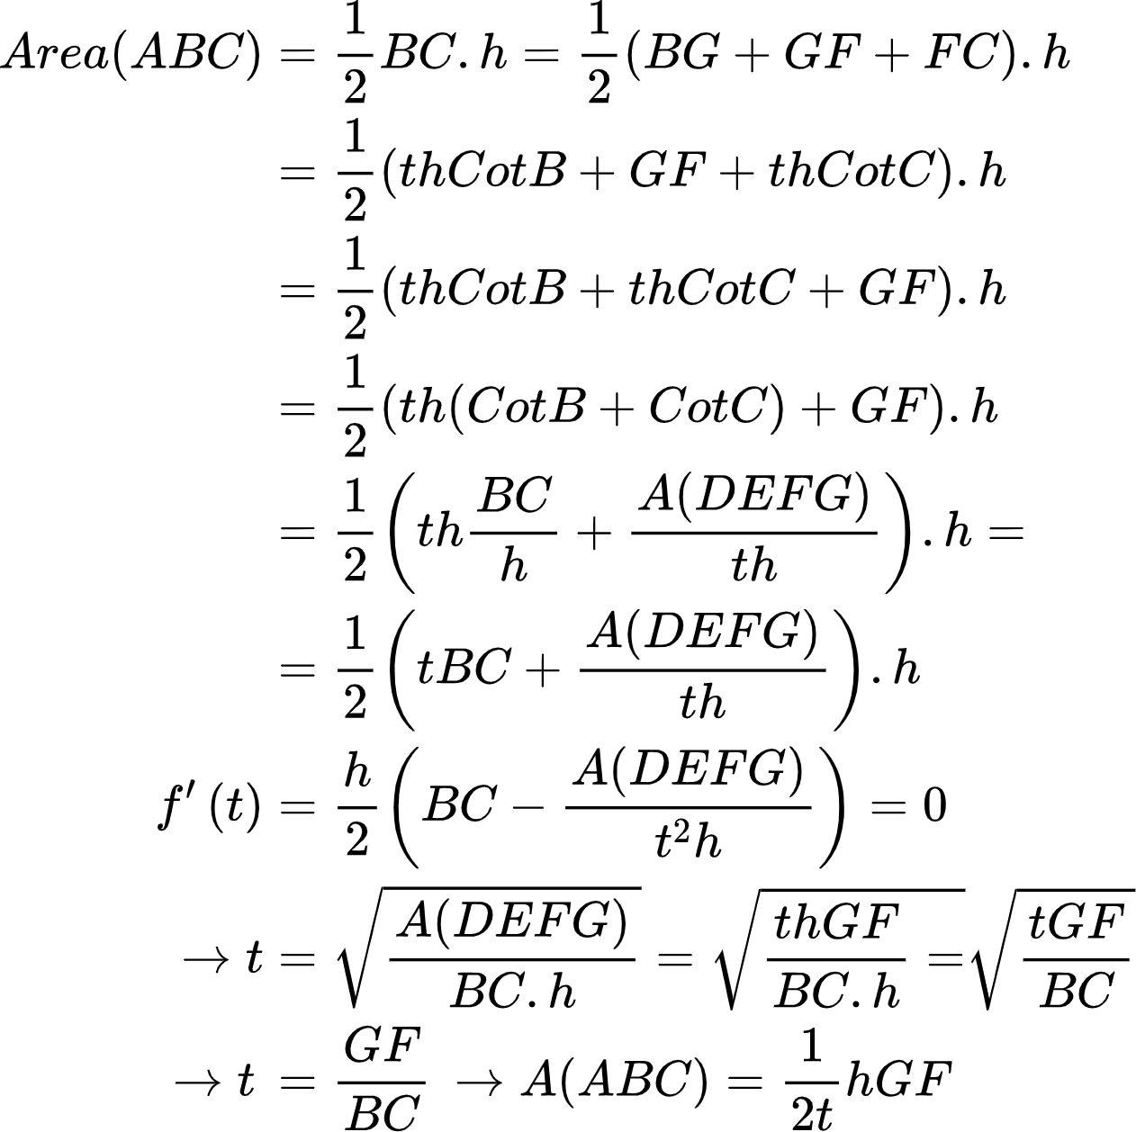
A
h
D
E
th
G
B
F
C

Slide 12
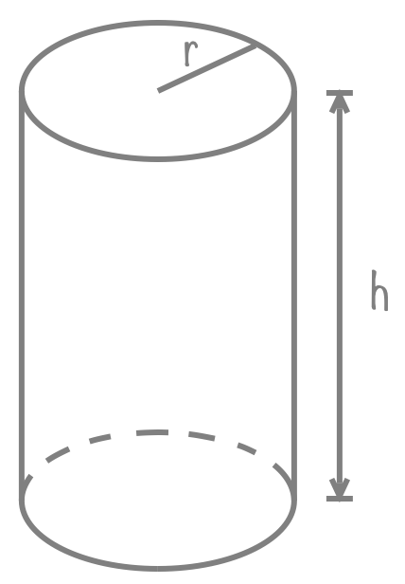
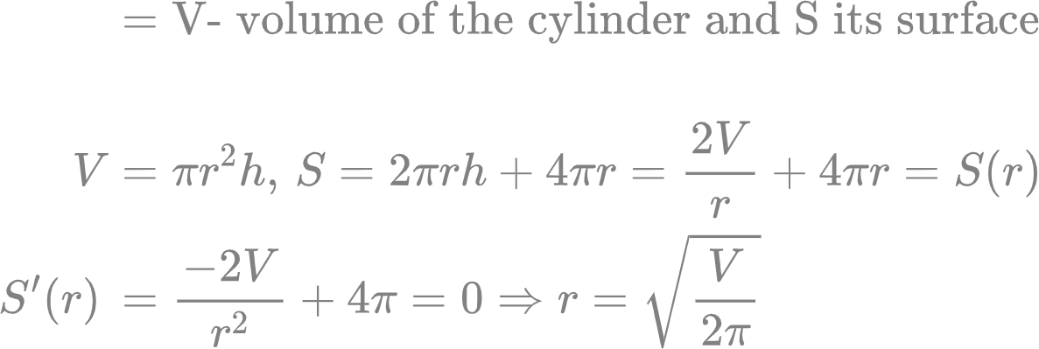
Given that a cylindrical can of soda must contain 330ml, which is 330
cm³, what dimensions, radius and height, must the can have to
minimize its surface area?

Slide 13
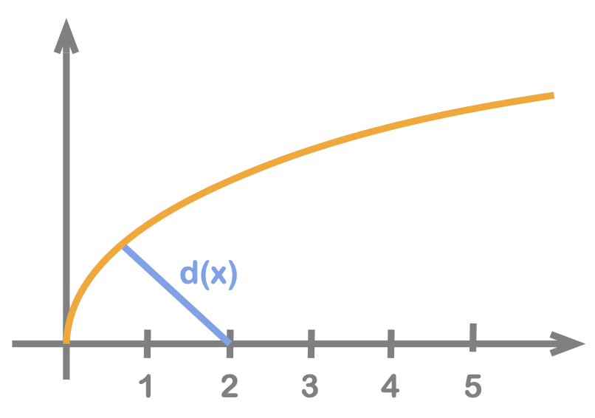
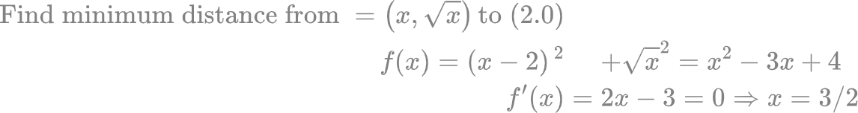
Distance of a curve from a point
Find the smallest distance from point(2,0) to the curve y=sqrt(x)
Any point on the curve has coordinates (x,sqrt(x)). So distance d is

Slide 14
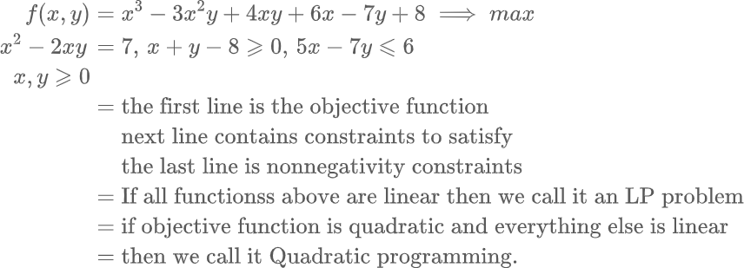
Mathematical Programming
An MP of defined by one or more objective functions, some constraints and nonnegativity constraints.

Slide 15
Mathematical Programming
The region that satisfies all constraints is called feasible region.

Slide 16
Mathematical Programming
Math Prog
Nonconvex
Convex
Quadratic
Linear

Slide 17
Find the largest triangle with the given perimeter
c
b
a

Slide 18
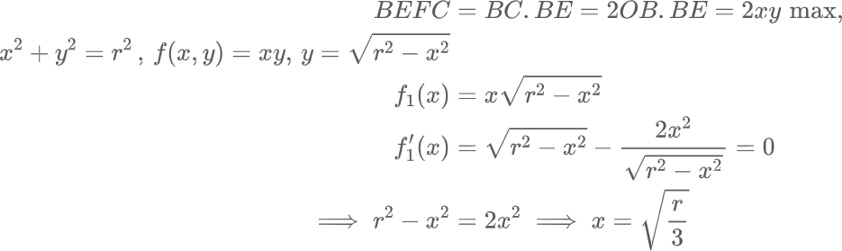
Largest rectangle on a half circle
E
F
y
r
x
A
D
B
O
C

Slide 19
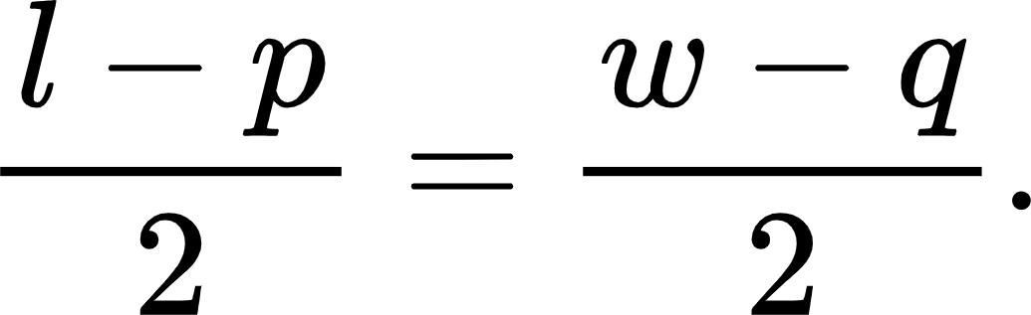
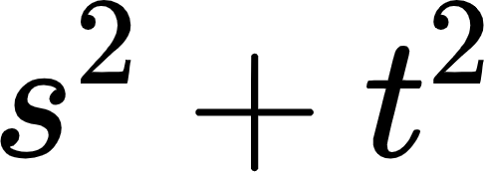
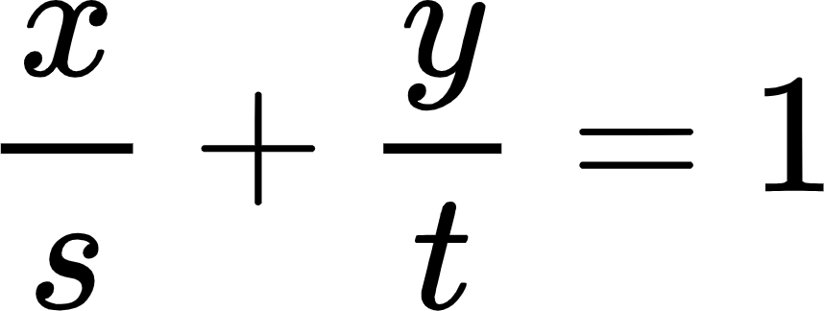
Optimization using calculus
3. Let ABCD be a large rectangular building of length l and width w. Inside this building there is a room of length p and width q but located symmetrically with corridor of width The problem is to determine the largest length of a stick that can be crawled along the corridor through the corners. Let any such stick has endpoints in the corner as s,0 and (0,t) making its length equalling . The equation of such a line can be written as
This equation must satisfy lower left corner of the red rectangle for the stick to be of the largest length. So

Slide 20
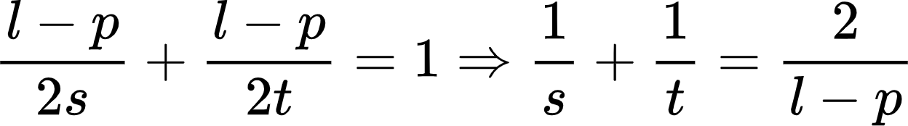
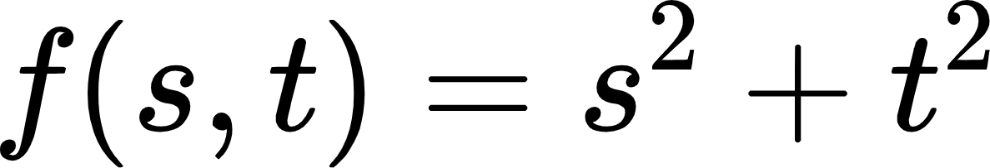
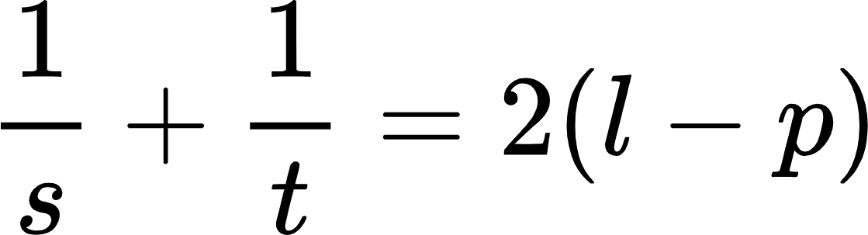
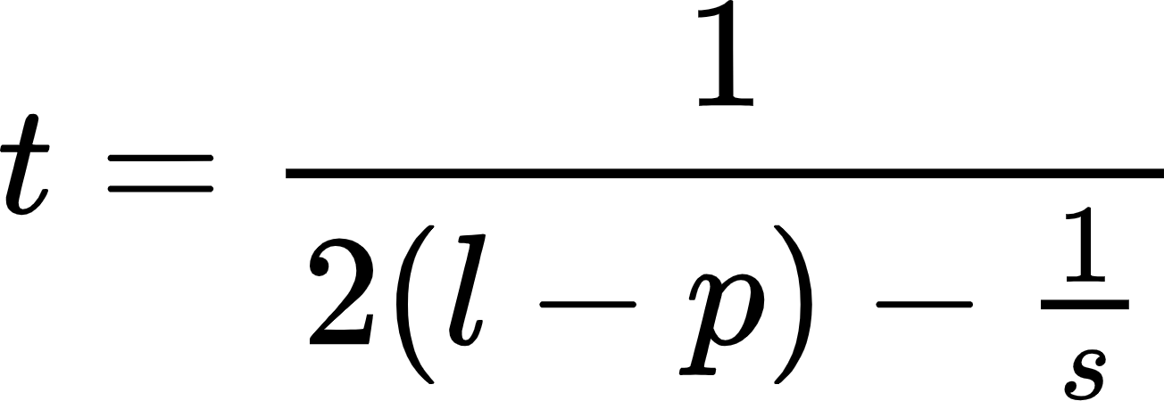
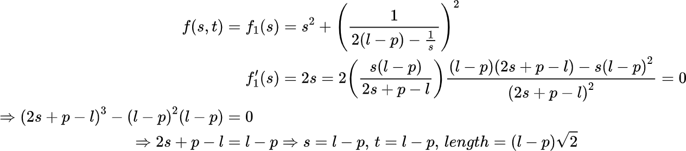
Optimization using calculus
So our optimization problem is to maximize
Subject to
So this is a constrained optimization problem. We can express
Putting the value of t in the formula for
q
w
p

Slide 21
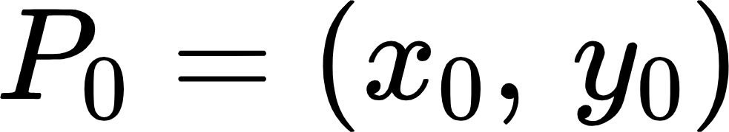
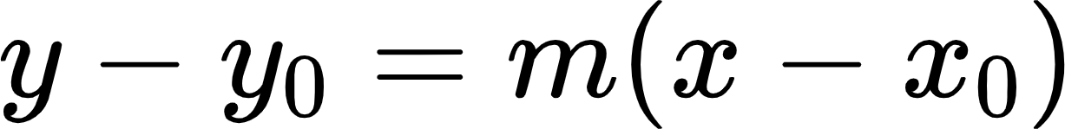
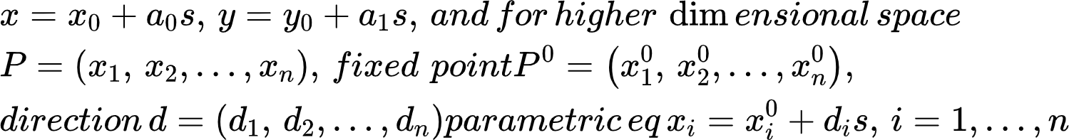
Optimization using calculus
4. Distance between two lines in 3D or higher dimensional space.
A straight line is a one dimensional object. A straight line can be defined by a point and a slope m and the equation is or in or in parametric form as Let the equation of the other straight line be
Let us define the second line

Slide 22
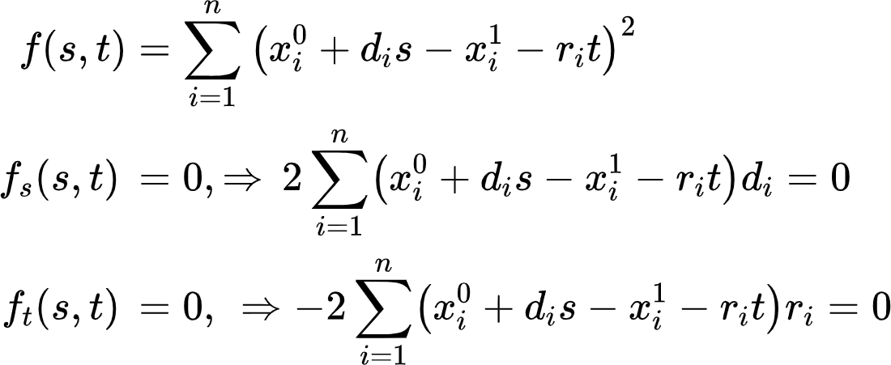
Optimization using calculus
Now distance from a point on the 1st line to a point on the 2nd line will be a function f(s,t) of s and t as follows. Solving 2 equations in 2 unknowns will give the minimum distance and corresponding points.

Slide 23
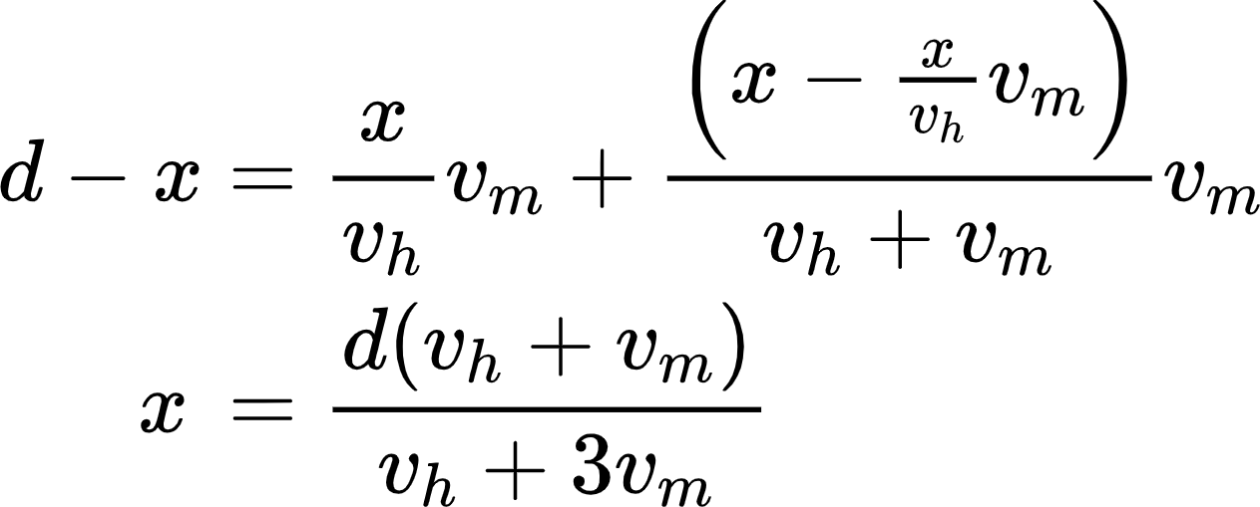
An Analytical Problem
5a The Horse Problem
Two friends want to undertake the equation is a journey from hall to the playground of distance d with the only well trained horse they have that is capable to carry only one of them at a time. Speed of horse vh. Each person speed vm .They want to start the journey together and reach the destination together in minimum time. How can they plan for the journey and what is the minimum time required for the journey?
In order for them to require the same amount of time both of them should walk the same distance and on horse top as well they will have to be the same amount of time.
d

Slide 24
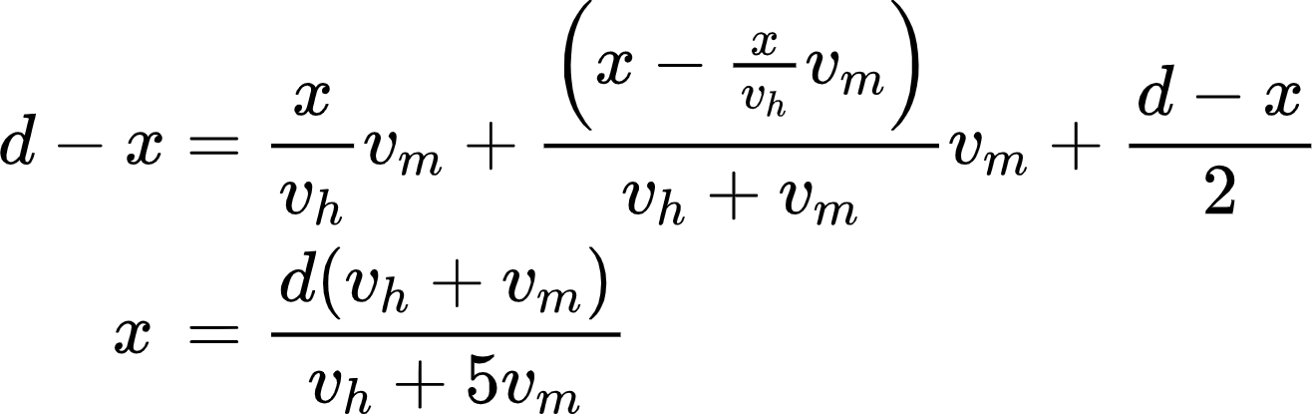
An Analytical Problem
5b. Solve the problem for 3 friends and one horse.
Solution: Horse will make backward movement equal amount of time for the 2nd and 3rd friends. Let d be the total distance and vhvm be the speeds of horse and friends respectively.
A---------------------------------------------------------------------B
1st---------------------------------------- X===========
2nd=====-----------------------------------------======
3rd============---------------------------------------
2nd friend walks xvhvm+(x-xvhvm)vmvm+vh the second fraction being for the horse to go back. So the third friend will again have to walk the same distance. So walking distance for the third friend will be equated to the first one

Slide 25
Linear Programming
1.2. Graphical Solution A linear programming problem with a few number of variables can be solved graphically by finding the vertices of the allowed values of the variables. We illustrate this solution method with an example. Example 1.1 (Production). A company can make two products with x₁ and x₂ being the amount of each and with profit f(x₁, x₂) = 8x₁ + 6x₂. Because of limits to the amounts of three inputs for production there are three constraints on production. The first input I1 restricts production by x₁ +x₂ ≤ 2, the second input I2 restricts 5x₁ + 10x₂ ≤ 16, and the third input I3 restricts 2x₁ + x₂ ≤ 3. Therefore the problem is Maximize: 8x₁ + 6x₂ (profit), Subject to: x₁ + x₂ ≤ 2, (I1) 5x₁ + 10x₂ ≤ 16, (I2) 2x₁ + x₂ ≤ 3, (I3) x₁ ≥ 0, x₂ ≥ 0.

Slide 26
Linear Programming
The function f(x₁, x₂) and all the constraint functions are linear so this is a linear programming problem. The feasible set F is the set of all the points satisfying the constraint equations and is the shaded region in Figure 1.2.1. The vertices of the feasible region are (0, 0), (1.5, 0), (1, 1), (0.8, 1.2), and (0, 1.6). Other points where two constraints are equal include the points

Slide 27
Linear Programming
3
2
1.6
(0.8,1.2)
(1,1)
(0,0)
1.5
2
3.2

Slide 28
Linear Programming
Example 1.2 (Minimization). Minimize: 3x₁ + 2x₂, Subject to: 2x₁ + x₂ ≥ 4, x₁ + x₂ ≥ 3, x₁ + 2x₂ ≥ 4, x₁ ≥ 0, and x₂ ≥ 0

Slide 29
Linear Programming(Exercises)
1.2.1. Consider the following maximization linear programming problem. Maximize 4x + 5y Subject to: x + 2y ≤ 12 x + y ≤ 7 3x + 2y ≤ 18 0 ≤ x, 0 ≤ y.
a. Sketch the feasible set.
b. Why must a maximum exist?
c. Find the maximal feasible solution and the maximal value using the geometric method.

Slide 30
Linear Programming(Exercises)
1.2.2. Consider the following linear programming problem: Minimize: 3x + 2y Subject to: 2x + y ≥ 4 x + y ≥ 3 x ≥ 0, y ≥ 0.
1. Sketch the feasible set.
2. Why must a minimum exist?
3. Find the optimal feasible solution and the optimal value using the geometric method.

Slide 31
Linear Programming(Exercises)
Consider the following minimization linear programming problem. Minimize 3x + 2y Subject to: 2x + y ≥ 4 x + y ≥ 3 3x + 2y ≤ 18 0 ≤ x, 0 ≤ y.
a. Sketch the feasible set.
b. Why must a minimum exist?
c. Find the minimal feasible solution and the minimal value using the geometric method.

Slide 32
Linear Programming(Exercises)
1.2.4. Show graphically that the following linear program does not have a unique solution: Maximize 30x + 40y Subject to: 3x + 4y ≤ 48 x + y ≤ 14 0 ≤ x, 0 ≤ y.
1.2.5. Consider the following maximization linear programming problem. Maximize 4x + 5y Subject to: x + 2y ≥ 0 2x − y ≥ 3 0 ≤ x, 0 ≤ y.
a. Sketch the feasible set.
b. Explain why the problem is unbounded and a maximizer does not exists.

Slide 33
Simplex Method
The graphical solution method is not a practical algorithm for most problems because the number of vertices for a linear program grows very fast as the number of variables and constraints increase. Dantzig developed a practical algorithm based on row reduction from linear algebra. The first step is to add more variables into the standard maximization linear programming problem to make all the inequalities of the form x_{i} ≥ 0 for some variables x_{i} .

Slide 34
Simplex Method
1.3.1. Slack Variables Definition. For a resource constraint, a slack variable can be set equal to the amount of unused resource: The inequality a_{i1}x₁ + · · · + a_{in}x_{n} ≤ b_{i} with slack variable si becomes a_{i1}x₁ + · · · + a_{in}x_{n} + s_{i} = b_{i} with s_{i} ≥ 0. Example 1.3. The production linear program given earlier has only resource constraints: Maximize: 8x₁ + 6₂x, Subject to: x₁ +x₂ ≤ 2, 5x₁ + 10₂ ≤ 16, 2x₁ +x ₂ ≤ 3, x₁ ≥ 0, ₂ ≥ 0.
When the slack variables are included the equations become x₁ +x₂ + s₁ = 2 5x₁ + 10x₂+ s₂ = 16, 2x₁ + x₂ + s₃ = 3.

Slide 35
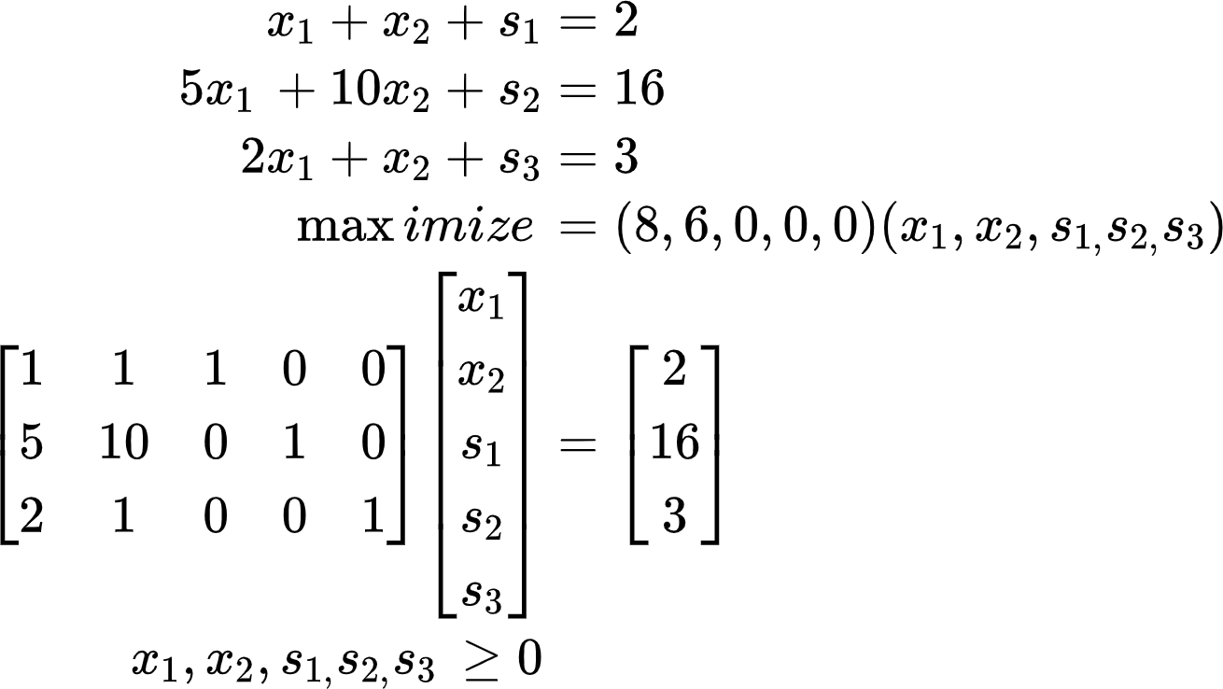
Simplex Method

Slide 36
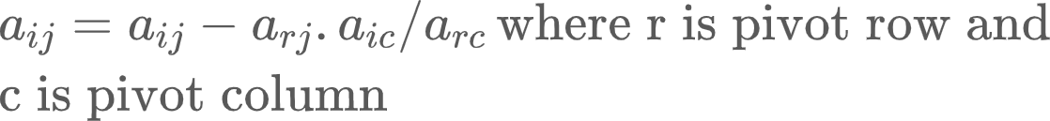
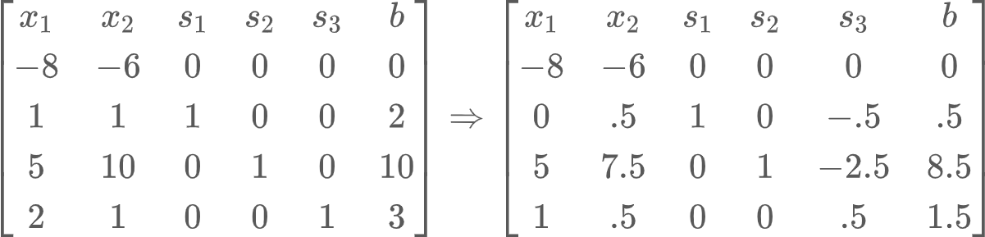
Simplex Method
Negative sign in the objective function rows indicate possibility of a better solution by reducing a basic variable (having positive value) into nonbasic and vice versa. In this example x1 can be made basic and s3 nonbasic by minimum ratio rule. Column of x1 becomes unit vector, row is divided by pivoting element 2 other elements are calculated using rectangular rule.

Slide 37
Simplex Method
Steps in the Simplex Method with only Resource Constraints
1. Add a slack variable for each resource inequality and set up the tableau. An initial feasible solution is determined by setting all the original variables equal to zero and solving for the slack variables.
2. Choose as entering variable any non-basic variable with a negative entry in the objection function row. We usually use the most negative entry. (The entry must be negative in order for the result of the pivoting to be an increase in the objective function.)
3. From the column selected in the previous step, select as a new pivot the row for which the ratio of entry in the augmented column divided by the entry in the column selected is the smallest nonnegative value. If such a pivot position exists, then row reduce the matrix making this selected entry a new pivot position and all the other entries in this column zero. (The pivot position must have a positive entry with the smallest ratio so that this variable becomes zero for the smallest value of the entering variable.) One pivoting step interchanges one free variable with one basic variable. The variable for the column with the new pivot position is the entering variable that changes from a free variable equal to zero to a basic variable which is nonnegative and usually positive. The departing variable is the old basic variable for the row of the new pivot position which becomes a free variable with value zero

Slide 38
Simplex Method
Steps in the Simplex Method with only Resource Constraints
3. If there is a column with a negative coefficient in the objective function row and only nonpositive entries in the column above, then the objective function has no upper bound and the problem is unbounded. We illustrate this case with an exercise. 4. The solution is optimal when all entries in the objective function row are nonnegative. This tableau is called the optimal tableau. 5. For the optimal tableau, if there is a zero entry in the objective function row for a non-basic variable with a positive entry in the column, then a different set of basic variables is possible. If, in addition, all the basic variables are positive, then the optimal solution is not unique.

Slide 39
Simplex Method
Steps in the Simplex Method with only Resource Constraints
1.3.3. General Constraints We proceed to consider non-resource constraints. We continue to take all the constants b_{i} ≥ 0 by multiplying one of the inequalities by 1 if necessary. Requirement Constraints. A requirement constraint is given by a_{i1}x₁ + · · · + a_{in}x_{n} ≥ b_{i} with b_{i} > 0. Such inequalities occur especially for a minimization problem. A solution of a requirement constraint can have a surplus of quantity, so instead of adding on the unused resource with a slack variable, we need to subtract off the excess resource by means of a surplus variable si ≥ 0, a_{i1}x₁ + · · · + a_{in}x_{n} − s_{i} = b_{i} . In order to find an initial feasible solution, for each requirement constraint, we also add an artificial variable r_{i} ≥ 0, resulting in the equation a_{i1}x₁ + · · · + a_{in}x_{n} − s_{i} + r_{i} = bi , An initial solution is formed by setting the artificial variable r_{i} = b_{i} > 0, while setting all the surplus variables si = 0 and all the xj = 0. Equality Constraints. For an equality constraint a_{i1}x₁ + · · · + a_{in}x_{n} = b_{i} with b_{i} ≥ 0, we only add an artificial variable ri ≥ 0, resulting in the equation a_{i1}x₁ + · · · + a_{in}x_{n} + r_{i} = b_{i} . An initial solution is r_{i}= b_{i} while all the xj = 0. Since initially, ri = b_{i} ≥ 0, r_{i} will remain non-negative throughout the row reduction. (Alternatively, we could replace the equality by two inequalities a_{i1}x₁ + · · · + a_{in}x_{n} ≥ b_{i} and a_{i1}x₁ + · · · + a_{in}x_{n} ≤ b_{i} , but this involves more equations and variables.) If either requirement constraints or equality constraints are present, the initial solution has all the xi = 0 and all the surplus variables equal zero while the slack and artificial variables are greater than or equal to zero. This initial solution is not feasible if an artificial variables is positive for a requirement constraint or an equality constraint.

Slide 40
Simplex Method
Steps in the Simplex Method with any Type of Constraints
1. Make all the constraints on the right hand side of any inequality or equation positive, b_{i} ≥ 0, by multiplying by 1 if necessary.
2. Add a slack variable for each resource inequality, add a surplus variable and an artificial variable for each requirement constraint, and add an artificial variable for each equality constraint.
3. If either a requirement constraint or an equality constraint is present, then form the artificial objective function by taking the negative sum of all the equations that contain artificial variables, dropping the terms involving the artificial variables. Set up the tableau. (The row for the artificial objective function has zeroes in the columns of the artificial variables.) An initial solution of the equation including the artificial variables is determined by setting all the original variables x_{j} = 0, all the surplus variables s_{i} = 0, all the slack variables s_{i} = b_{i} , and all the artificial variables a_{i} = b_{i} .
4. Apply the simplex algorithm using the artificial objective function.
a. If it is not possible to make the artificial objective function equal to zero i.e., if there is a positive artificial variable in the optimal solution of the artificial objective function), then there is no feasible solution and stop.
b. If the value of the artificial objective function can be made equal to zero (when the artificial variables are not pivot columns), then all the artificial variables have been made equal to zero. (This is true even if some of the entries in the artificial objective function row are nonzero and possibly even negative.) At this point, drop the artificial variables and artificial objective function from the tableau and continue using the initial feasible basic solution constructed.
5. Apply the simplex algorithm to the actual objective function. The solution is optimal when all entries in the objective function row are nonnegative.

Slide 41
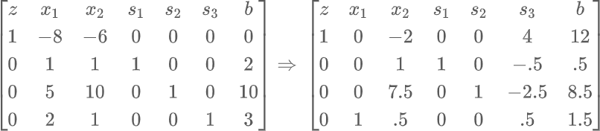
Simplex Method

Slide 42
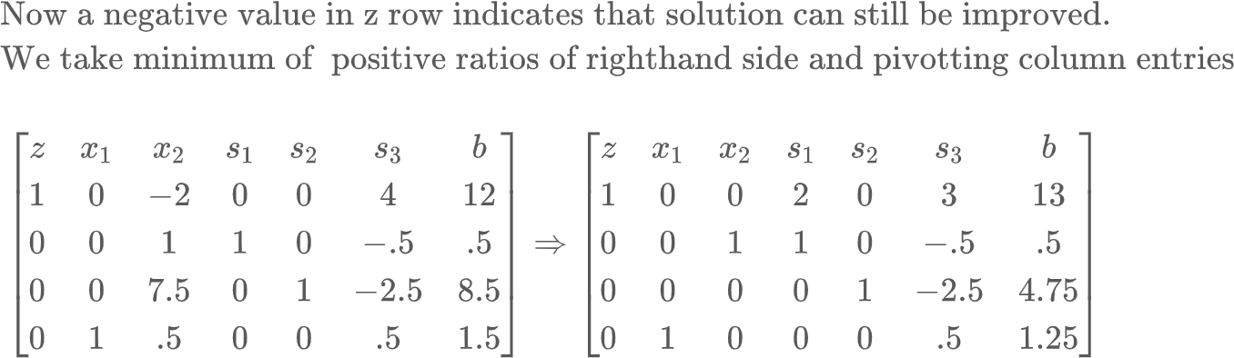
Simplex Method

Slide 43
Simplex Method

Slide 44
Simplex Method
Example 1.6. Consider the problem of Maximize: 3 x₁ + 4 x₂ Subject to: 2 x₁ + x₂ ≤ 6, 2 x₁ + 2 x₂ ≥ 24, x₁ = 8, x₁ ≥ 0, x₂ ≥ 0. With slack, surplus, and artificial variables added the problem becomes Maximize: 3 x₁ + 4 x₂
Subject to: 2 x₁ + x₂ + s₁ = 6,
2 x₁ + 2 x₂ − s₂ + r₂ = 24,
x₁ + r₃ = 8.
The negative sum of the second and third equation, gives the artificial objective function 3 x₁ − 2 x₂ + s₂ − r₂ − r₃ = 32.

Slide 45
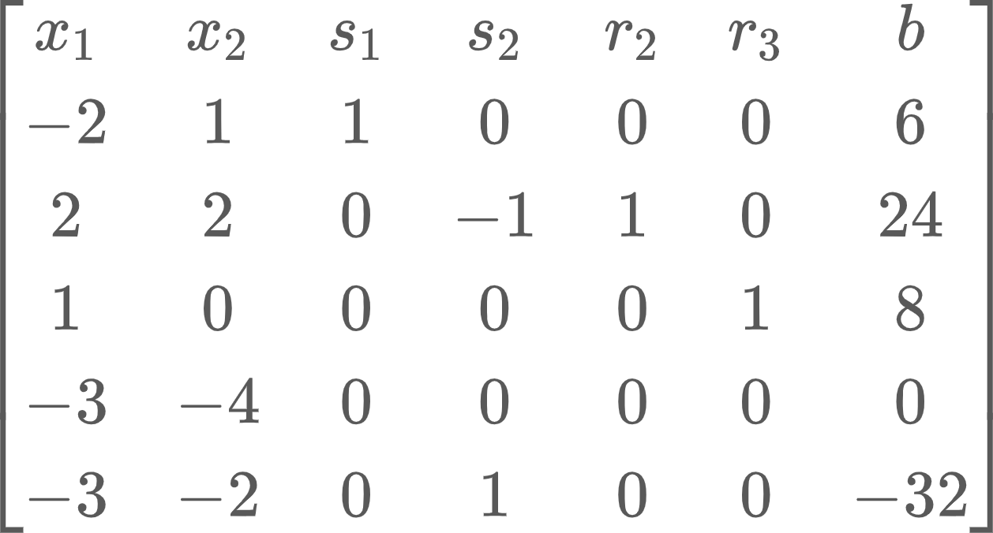
Simplex Method
The tableau with variables is

Slide 46
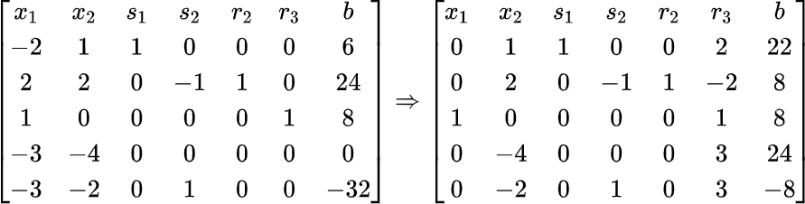
Simplex Method
Pivoting on a₃₁ and then on a₂₂

Slide 47
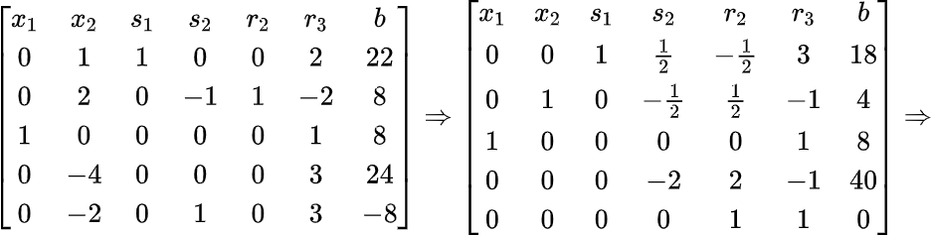
Simplex Method

Slide 48
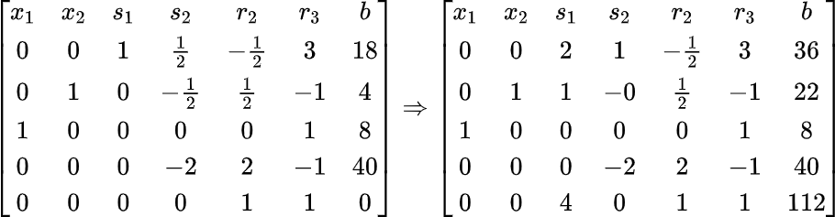
Simplex Method

Slide 49
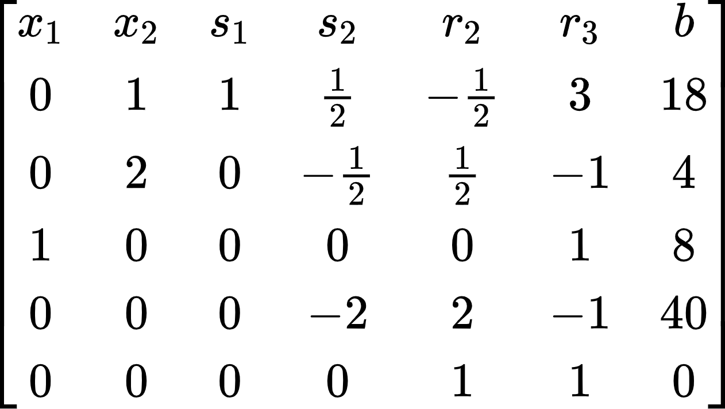
Simplex iteration
The tableau with variables is

Slide 50
Simplex Method
Fundamental Property of the Simplex Method. The simplex method (with perturbation if necessary) solves any given linear program in a finite number of iterations. That is, in a finite number of iterations, it shows that there is no feasible solution; finds an optimal solution; or shows that the objective function is unbounded over the feasible region.
Fundamental Property of Linear Equations. If a set of linear equations in nonnegative variables is feasible, then there is an extreme-point solution to the equations.

Slide 51
Simplex Method
Definition. The shadow price associated with a particular constraint is the change in the optimal value of the objective function per unit increase in the righthand-side value for that constraint, all other problem data remaining unchanged.
In Chapter 1 we implied that the shadow prices were readily available when a linear program is solved. Is it then possible to determine the shadow prices from the final tableau easily? The answer is yes, in general, but let us consider our example for concreteness. Suppose that the production capacity in the first constraint of our model
6x₁ + 5x₂ + 8x₃ + x₄ = 60

Slide 52
Simplex Method
Since x₄ is a slack variable, it does not appear in any other constraint of the original model formulation, nor does it appear in the objective function. Therefore, this replacement does not alter any other righthand- side value in the original problem formulation. What is the contribution to the optimal profit of this additional unit of capacity? We can resolve this question by looking at the objective function of the final tableau

Slide 53
Simplex Method
The optimality conditions of the simplex method imply that the optimal solution is determined by setting the nonbasic variables x3 = x4 = x5 = 0, which results in a profit of 51(3/ 7)
. Now, if we are allowed to make x4 = −1, the profit increases by 11/14 hundred dollars for each additional unit of capacity available. This, then, is the marginal value, or shadow price, for production hours.

Slide 54
Simplex Method
In this way we can consider variation in the coefficients of the objective function, to the right hand side even in entries of the main matrix.

Slide 55
Simplex Method
is increased from 60 to 61 hours. We then essentially are procuring one additional unit of production capacity at no cost. We can obtain the same result algebraically by allowing the slack variable x₄ to take on negative values. If x4 is replaced by x₄ − 1 (i.e., from its optimal value x₄ = 0 to x₄ = −1), Eq.(6) becomes:
6x₁ + 5x₂ + 8x₃ + x₄ = 61,
which is exactly what we intended.

